Slide 1




Project NLP | Business Case:
Automated Customer
Reviews
Presented by:
Lina Alshammari
01

Slide 2
Table of contents
Product Category Clustering
01
Introduction
04
Summarize reviews using generative AI
Data Wrangling & Cleaning
05
02
06
Streamlit
Classification with pre-trained models
03
Conclusion
07
02

Slide 3
Introduction
Project objective:
Analyze customer ratings and reviews to understand customer sentiment and improve the shopping experience.
Project Idea:
Categorize reviews (positive, negative, neutral), group products into main categories (clustering), and generate smart summaries of the best products.
Tools Used:
Python، Pandas، scikit-learn، TensorFlow/Keras، HuggingFace Transformers، OpenAI API، Matplotlib، Seaborn.
03

Slide 4
Data Wrangling & Cleaning
Primary Dataset used:
Amazon product reviews
(Datafiniti_Amazon_Consumer_Reviews_of_Amazon_Products.csv).
Number of data: 5000
Number of rows: 5000
Number of columns: 24
Cleaning Data & Processing Steps:
I checked and there are no missing values ​​and I removed the duplicate.
Convert numeric ratings to categories (positive= 2, neutral= 1, negative= 0).
04

Slide 5
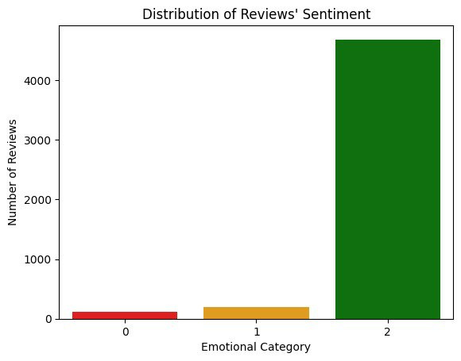
05

Slide 6
Classification with pre-trained models
The models:
distilbert-base-uncased: Lightweight and fast, ideal for limited resources.
roberta-base: More robust to nuanced sentiment variations.
The best model:
distilbert-base-uncased: Because it gave better results in training than roberta-base.
06

Slide 7
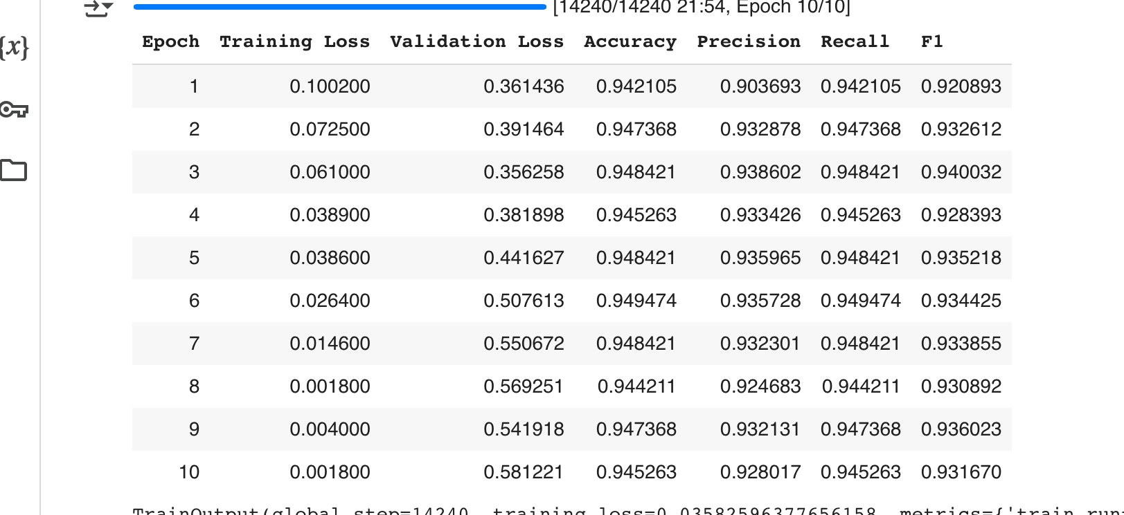
Results of modle distilbert-base-uncased :
The Evaluate :
Accuracy: 0.945
Precision: 0.928
Recall: 0.945
F1 Score: 0.931
07

Slide 8
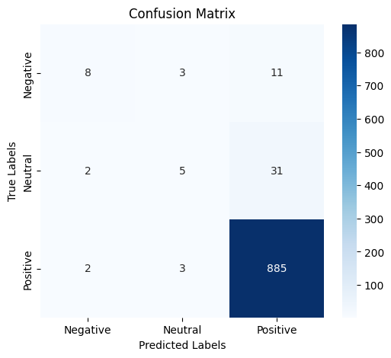
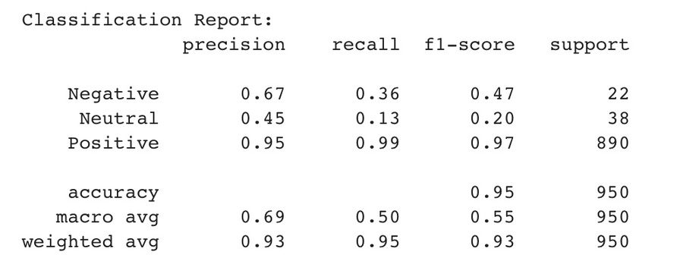
Product Category Clustering
Confusion Matrix & Classification Report :
08

Slide 9
Product Category Clustering
Product Category Clustering
Objective:
Simplify the dataset by clustering product categories into 4 meta-categories.
Embeddings:
I choes K-means with k=4.
I chose the name column: because it best sorts the clusters to the nearest category.
Category Custer:
0 (Fire table ) —> 1869
2 (Kindle) —> 1664
3 (Audio and video ) —> 778
1 (Fire tables for kids) —> 689
09

Slide 10
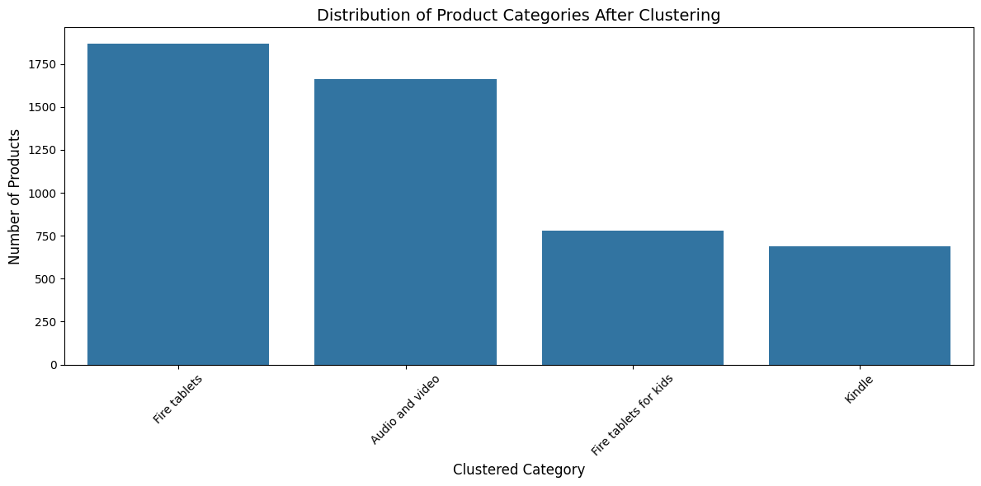
Product Category Clustering
Product Category Clustering
10

Slide 11
Summarize reviews using generative AI
Summarize reviews using generative AI
Objective:
Summarize reviews into articles that recommend the top products for each category.
Create a model that generates a short article for each product category.
Pretrained Generative Model: I used gpt-3-5-turbo
Final result:
Top 3 products and key differences between them.
Top complaints for each of those products.
Worst product in the category and why it should be avoided.
11

Slide 12
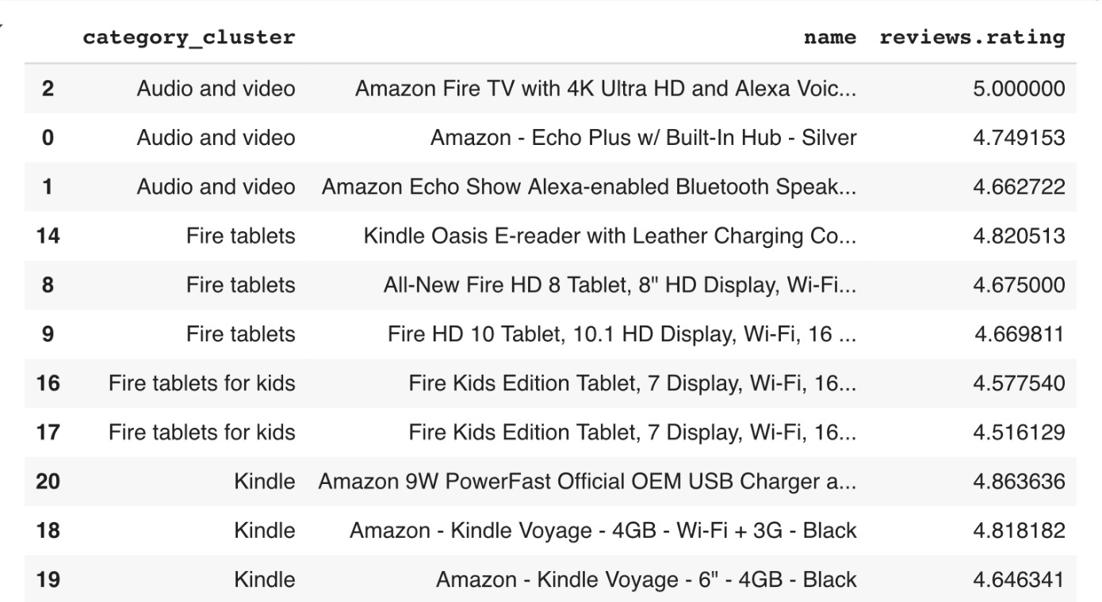
Summarize reviews using generative AI
Top 3 products in each category
12

Slide 13
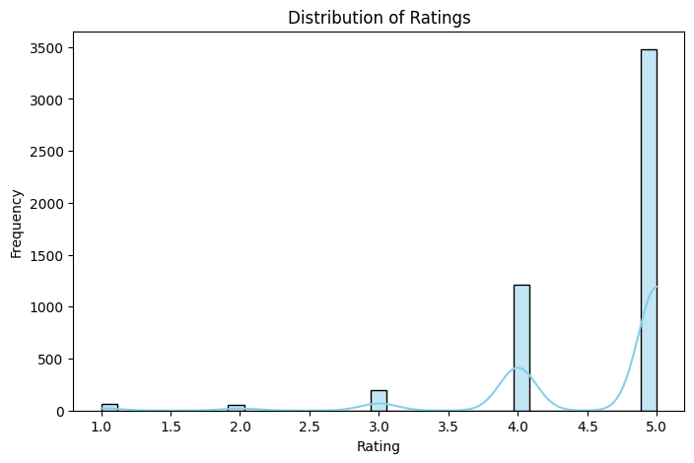
Summarize reviews using generative AI
Representation of Ratings:
13

Slide 14
Summarize reviews using generative AI
Sample of Final Results
Article for Category: Fire tablets for kids
Based on the reviews provided, it is clear that the Fire Kids Edition Tablets are a hit among children and parents alike. Here are the top 3 recommended products in the 'Fire tablets for kids' category:
1. Fire Kids Edition Tablet, 7 Display, Wi-Fi, 16 GB, Blue Kid-Proof Case:
Key differences: This tablet comes in a blue kid-proof case, which is reported to be sturdy and durable. The screen is larger and the bumper is stronger compared to other models.
Top complaints: There were no major complaints mentioned in the reviews.
Recommendation summary: This tablet is a great option for parents looking for a durable and easy-to-use device for their kids.
2. Fire Kids Edition Tablet, 7 Display, Wi-Fi, 16 GB, Green Kid-Proof Case:
Key differences: This tablet comes in a green kid-proof case and allows for setting up different profiles for multiple children. It offers a variety of features to keep kids entertained.
Top complaints: Some users found it confusing to navigate compared to other brands like Samsung.
Recommendation summary: This tablet is perfect for families with multiple children, as it allows for personalized profiles and offers a wide range of entertainment options.
14

Slide 15
Summarize reviews using generative AI
Sample of Final Results
3. Fire Kids Edition Tablet, 7 Display, Wi-Fi, 16 GB, Pink Kid-Proof Case:
Key differences: This tablet comes in a pink kid-proof case, suitable for kids who prefer a more colorful option. It offers a user-friendly interface and a variety of educational apps.
Top complaints: There were no major complaints mentioned in the reviews.
Recommendation summary: This tablet is a great choice for parents looking for a fun and educational device for their kids.
In conclusion, the Fire Kids Edition Tablets are highly recommended for their durability, ease of use, and entertainment value. Whether you choose the blue, green, or pink kid-proof case, you can be sure that your child will enjoy hours of fun and learning with these tablets.
15

Slide 16




Studio Shodwe
Home
Service
About Us
Contact
Search . . . .
Streamlit
16

Slide 17


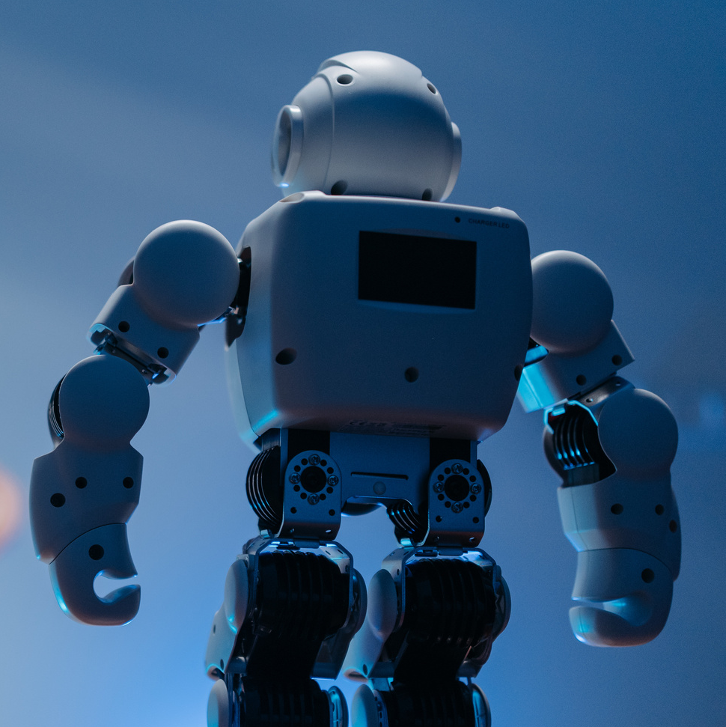
Conclusion
This project was designed to provide insights into how to process customer review data using classification models, product clustering techniques, and text summarization models. We covered every step of the pipeline from data cleaning, model training, evaluation, to generating product summaries using generative models like GPT-3.5.
17

Slide 18
Thank You
For Watching
End Slide
18

